Slide 1

Latte: A Language, Compiler, and Runtime for Elegant and Efficient Deep Neural Networks
Leonard Truong^{φ, τ}, Rajkishore Barik^{τ}, Ehsan Totoni^{τ}, Hai Liu^{τ}, Chick Markley^{φ}, Armando Fox^{φ}, Tatiana Shpeisman^{τ}
^{τ}Intel Labs, ^{φ}UC Berkeley

Slide 2
Deep Learning Research is Thriving
Academia
Industry
Thanks Ben Zorn
# of deep learning papers
http://jponttuset.github.io/xkcd-deep-learning/
2
Notes:
Amazon echo
Apple siri
Amazon bing
Board games

Slide 3
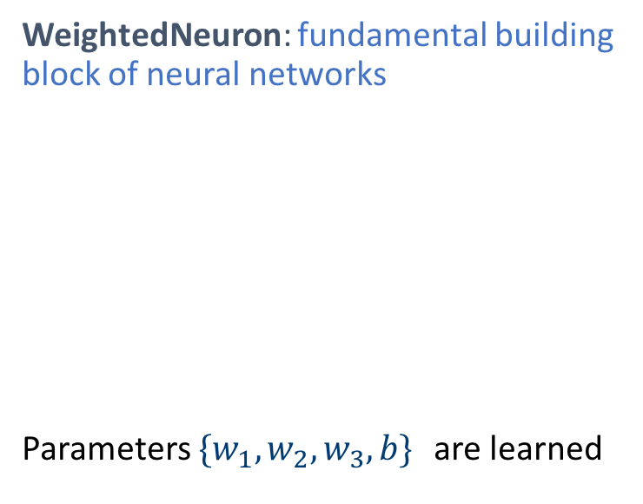
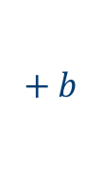

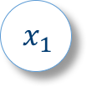
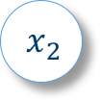
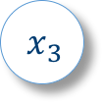


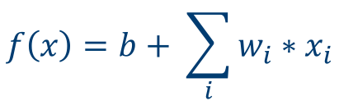
Deep Learning 101
Neural networks: family of biologically inspired, machine-learning models
Neurons are organized into layers
DNN Architecture/Model: a specific configuration of layers
WeightedNeuron: fundamental building block of neural networks
Parameters ${\{w}_{1},w_{2}, w_{3}, b\}$ are learned
$$x_{1}$$
$${∗w}_{1}$$
$$x_{2}$$
$${∗w}_{2}$$
$$+ b$$
$$x_{3}$$
$${∗w}_{3}$$
$$f\left(x\right)=b+ \sum_{i}{w_{i}∗x_{i}}$$
Layer 1
Layer 2
Layer 3

Slide 4
Deep Learning 101
Forward Activations
Training neural networks
For each training sample
Forward propagation
Back propagation
Update parameters
Typically process the entire training data set multiple times
Backward Gradients
Notes:
Krizhevsky quote from 2012 alexnet paper
In the end, the network’s size is limited mainly by the amount of memory available on current GPUs and by the amount of training time that we are willing to tolerate. Our network takes between five and six days to train on two GTX 580 3GB GPUs. All of our experiments suggest that our results can be improved simply by waiting for faster GPUs and bigger datasets to become available.

Slide 5
Deep Learning Research
New Layers New Network Architectures
What’s the best programming environment for deep learning research?
Parametric Rectified Linear Unit
Batch Normalization
Dropout
Maxout
Inception Architectures
Residual Learning Architectures
AlexNet
2013
2014
2015
2016
A very incomplete list of deep learning advancements
Can take days to weeks to evaluate a new idea
AlexNet 5-6 days [Krizhevsky et al. NIPS ‘12]
VGG 2-3 weeks [Simonyan et al. ICLR ‘15]
Notes:
Deep networks can take days/weeks to train on even high end systems

Slide 6
Deep Learning Software Landscape
Layer Specific Libraries
Provide a function for each layer
Examples: cuDNN, Caffe, NNPACK, …
Good performance
Hard to program
Cannot fuse across layers
Notes:
Low level libraries
Good performance but requires expert programming skills for new layers
Trades increased programming time for reduced training time
Graph engines
Easier programming but compiler optimization on tensors is hard
Trades reduced programming time for increased training time

Slide 7
Deep Learning Software Landscape
Computational Graph Engines
DNNs can be expressed as graphs of general operations
Examples: Theano, CNTK, TensorFlow, …
Easier to program
Sacrifice performance
Many rely on bindings to cuDNN
Notes:
Low level libraries
Good performance but requires expert programming skills for new layers
Trades increased programming time for reduced training time
Graph engines
Easier programming but compiler optimization on tensors is hard
Trades reduced programming time for increased training time

Slide 8
Deep Learning Software Landscape
Notes:
Low level libraries
Good performance but requires expert programming skills for new layers
Trades increased programming time for reduced training time
Graph engines
Easier programming but compiler optimization on tensors is hard
Trades reduced programming time for increased training time

Slide 9
Introducing Latte
DSL
Language for describing DNNs as a system of interconnected neurons
Compiler
Constructs an implicit data-flow graph from user description
Synthesizes and optimizes an implementation of the data-flow graph
Runtime
Supports distributed memory parallelism for data-parallel training
Competitive Performance
3-6x speedup over Caffe (C++/MKL) on a single node
Notes:
DSL
matches domain concepts to facilitate design of novel layers
Hides platform specific details like vectorization and parallelization
Compiler
Efficient code generation for new and classical layers
Domain-specific optimizations including cross-layer fusion and tiling
Runtime
Supports data-parallel training on heterogeneous clusters
Automatically offloads to accelerators such as Xeon

Slide 10
Latte System Diagram
Network
Description
Julia Embedded DSL Frontend
Data-flow
Graph
Synthesis
Binary
x86 Backend
Optimizations
Latte IR
Parallel Runtime

Slide 11
Latte DSL Frontend
Network
Description
Julia Embedded DSL Frontend
Data-flow
Graph
Synthesis
Binary
x86 Backend
Optimizations
Latte IR
Parallel Runtime

Slide 12
Latte DSL: Introduction
Embedded in
Notes:
Neural Networks are constructed by creating collections of Neurons called Ensembles and applying Connections between them
Julia
Syntactically similar to Matlab and Python

Slide 13
Latte DSL: Neuron
Neuron – Primitive, abstract data-type
User can
Define additional fields for internal state (optional)
Implement forward and backward functions (required)
type Neuron value :: Float32 ∇ :: Float32 inputs :: Vector{Float32} ∇inputs :: Vector{Float32} end

Slide 14
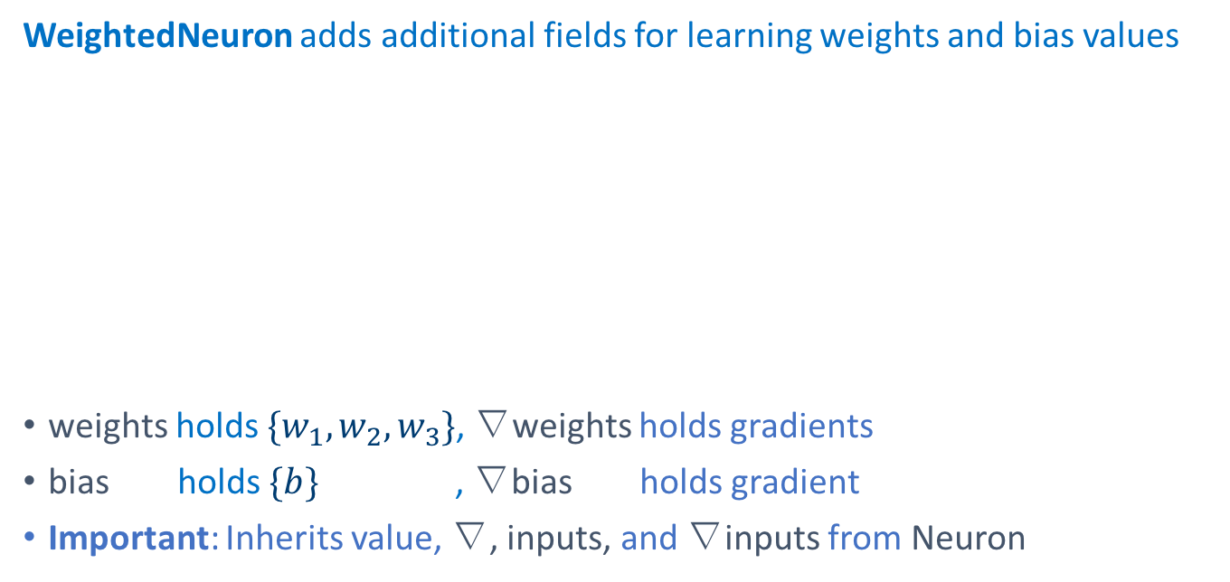
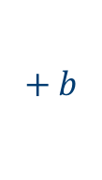

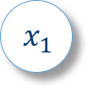
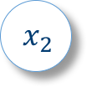



Latte DSL: Neuron Example
WeightedNeuron adds additional fields for learning weights and bias values
weights holds ${\{w}_{1},w_{2}, w_{3}\}$, ∇weights holds gradients
bias holds $\{b\}$ , ∇bias holds gradient
Important: Inherits value, ∇, inputs, and ∇inputs from Neuron
@neuron type WeightedNeuron <: Neuron weights :: Vector{Float32} ∇weights :: Vector{Float32} bias :: Float32 ∇bias :: Float32 end
$$x_{1}$$
$${∗w}_{1}$$
$$x_{2}$$
$${∗w}_{2}$$
$$+ b$$
$$x_{3}$$
$${∗w}_{3}$$
Notes:
Bias is a vector so that it can be shared between different instances

Slide 15





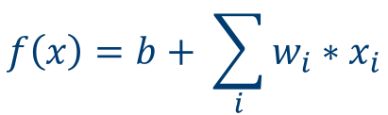
Latte DSL: Neuron Forward Example
$$x_{1}$$
$${∗w}_{1}$$
The forward propagation of a WeightedNeuron
$$x_{2}$$
$${∗w}_{2}$$
$$+ b$$
$$f\left(x\right)=b+ \sum_{i}{w_{i}∗x_{i}}$$
$$x_{3}$$
$${∗w}_{3}$$
@neuron forward(neuron::WeightedNeuron) do
for i in 1:length(neuron.inputs)
neuron.value += neuron.weights[i] * neuron.inputs[i]
end
neuron.value += neuron.bias
end

Slide 16
Latte DSL: Ensemble
An Ensemble is an N-dimensional array of a Neuron subtype T
type Ensemble{T <: Neuron, N}
name :: Symbol
neurons :: Array{T,N}
connections :: Vector{Connection}
...
end

Slide 17
Latte DSL: Connections
Connections between a source ensemble and a sink ensemble are defined using a mapping function
1
1
2
2
3
3
add_connections(net, source, sink, (i) -> (i:i+1,)
4
source
sink
1
2
3
1:2
2:3
3:4
Notes:
Given the index of a neuron in the sink the mapping function returns a range of indices of connected neurons in the source

Slide 18
Bringing it all together: Fully Connected Layer
# Create a 1-D array of `num_outputs` WeightedNeurons
neurons = [WeightedNeuron(weights[:, i], ∇weights[:, i],
bias[:, i] , ∇bias[:, i])
for i in 1:num_outputs]
# Construct the ensemble
ens = Ensemble(net, name, neurons)
# Connect each neuron in input_ensemble add_connections(net, input_ensemble, ens,
(i) -> (1:d for d in size(input_ensemble))
input_ensemble
ens

Slide 19
Latte Compiler
Network
Description
Julia Embedded DSL Frontend
Data-flow
Graph
Synthesis
Binary
x86 Backend
Optimizations
Latte IR
Parallel Runtime

Slide 20
Latte Compiler: Synthesis
User implicitly describes a data-flow graph (DFG)
Stored implicitly by mapping functions
Ensembles provide a natural partitioning of the DFG
Data-flow Synthesis
Copy output values of connected neurons into an input buffer for an ensemble
Compute Synthesis
Perform the computation of neurons in an ensemble
Distributed Memory Communication
Asynchronously synchronize gradients
Notes:
The DFG is internally stored implicitly using mapping functions
Ensembles provide a natural partitioning of the DFG
Data-flow synthesis – emits code to copy data dependencies for an ensemble into a memory buffer
Compute synthesis – transforms neuron forward/backward definitions and synthesizes loops to execute the computation of an ensemble

Slide 21
Latte Compiler: Optimizations
Cross Layer Fusion (Covered in this talk)
Use dependence information from data-flow graph to fuse loops across layers
Shared Variable Optimization (See paper)
Compiler analysis discovers values that are shared between neurons
Library Kernel Pattern Matching (See paper)
Replace matrix-multiplication loop nest patterns with MKL call
General Loop Optimizations (See paper)
Tiling, Fusion

Slide 22
Latte Compiler: Cross Layer Fusion Example
for y_tile in 1:TILE_SIZE:height gemm('T', 'N', TILE_SIZE*width, n_filters, n_inputs, conv1input[n], conv1weights, conv1[n]) for y_tile in 1:TILE_SIZE:height for c = 1:n_filters, y = y_tile:y_tile+TILE_SIZE, x = 1:width conv1[x, y, c] = max(conv1[x, y, c], 0.0) for y_tile in 1:TILE_SIZE:height/2 for c = 1:n_filters, y = y = y_tile:y_tile+TILE_SIZE, x = 1:width for p = 1:2, q = 1:2 poolinput[p*2+q, x, y, c] = conv1[x+q, y+p, c] maxval = -Inf for i = 1:pool_size maxval = max(poolinput[i, x, y, c], maxval) pool1[x, y, c] = maxval
Conv
Layer
Easily Fused
ReLU
Layer
Different Loop Lengths
Possible Fusion Preventing Dependency
Pooling
Layer

Slide 23
Latte Compiler: Cross Layer Fusion Example
for y_tile in 1:TILE_SIZE:height/2 gemm('T', 'N', TILE_SIZE*2*width, n_filters, n_inputs, conv1input[n], conv1weights, conv1[n]) for c = 1:n_filters, for y = y_tile:y_tile+TILE_SIZE*2, x = 1:width conv1[x, y, c] = max(conv1[x, y, c], 0.0) for y = y_tile:y_tile+TILE_SIZE, x = 1:width maxval = -Inf for p = 1:2, q = 1:2 maxval = max(conv1[x+q, y+p, c], maxval) pool1[x, y, c] = maxval
Key Takeaways
Fusing across layers is only possible in a dynamic compiler, static libraries cannot do this
Dependence information already provided by data-flow graph

Slide 24
Latte Runtime
Network
Description
Julia Embedded DSL Frontend
Data-flow
Graph
Synthesis
Binary
x86 Backend
Optimizations
Latte IR
Parallel Runtime

Slide 25
Latte Runtime
Manages data-parallel training on distributed memory systems
Gradients reduction is overlapped with forward/backward phases
Supports automatic offloading to accelerators (Xeon Phi)
Data movement to and from accelerator is overlapped with host compute
Notes:
Overlaps communication with computation on the host
Runs an instance of the network on each node
Uses MPI_Iallreduce to synchronize gradients

Slide 26
Evaluating Latte
Compared performance against open-source frameworks
Caffe [C++/MKL], Mocha.jl [Julia/MKL] (see paper for Mocha results)
Training throughput used as metric
Platforms in this talk:
Single node : Dual-socket Intel Xeon E5-2699 v3 (36 cores)
Supercomputer : NERSC Cori Phase 1 (info at nersc.gov)
More Platforms (see paper):
Accelerator Offloading (Xeon + Xeon Phi), Commodity Cluster

Slide 27
Latte Single Node Evaluation
3-6x speedup over Caffe for Training (Forward + Backward)

Slide 28
Latte Single Node Evaluation
Breakdown of optimization effectiveness for first 3 layers of VGG

Slide 29
Latte Single Node Evaluation
First 16 layers of VGG
Breakdown of speedup for VGG (Forward)

Slide 30
Latte on Cori
Each worker is given a 512 / N sized sub-batch (N = number of Nodes)

Slide 31
Conclusion
Developed a novel abstraction for describing neural networks
Demonstrated performance competitive with existing frameworks
Code: Latte.jl is available at https://github.com/IntelLabs/Latte.jl
Ongoing Work: Forthcoming release of Python implementation with new features and better performance
Notes:
Developed a novel abstraction for describing neural networks
Language matches domain concepts for productive exploration of novel layers
Supports distributed memory, data-parallel training
Demonstrated performance competitive with existing frameworks
Compiler dynamically synthesizes and optimizes implementations of networks
Code: Latte.jl is available at https://github.com/IntelLabs/Latte.jl
Ongoing Work: Python port of Latte will be released soon
Greatly improved performance with better vector code generation
Improved usability with reworked language constructs

Slide 32
Acknowledgements
Thanks to Brian Lewis, Lindsey Kuper, and Justin Gottschlich for their valuable feedback on the paper and presentations.
Thanks to Paul Hargrove at NERSC for access to Cori
For the UC Berkeley contributors, research was partially funded by DARPA Award Number HR0011- 12-2-0016, the Center for Future Architecture Research, a member of STARnet, a Semiconductor Research Corporation program sponsored by MARCO and DARPA, and AS- PIRE Lab industrial sponsors and affiliates Intel, Google, Hewlett-Packard, Huawei, LGE, NVIDIA, Oracle, and Samsung.

